Slide 1
Road Accident Detection And Prevention Using Alert System and Arduino
Submitted in the partial fulfillment for the award of the degree of
BACHELOR OF ENGINEERING
IN
CSE – Big Data Analytics
Submitted by:
Gaurav Kumar Pandit (20BCS3961)
Tanushree Gupta(20BCS3980)
Ashutosh Kumar (20BCS4359)
Under the Supervision of:
Prakash Mani Badal
Department of AIT-CSE
DISCOVER . LEARN . EMPOWER

Slide 2
Outline
Introduction to Project
Problem Formulation
Objectives of the work
Methodology used
Results and Outputs
Conclusion
Future Scope
References

Slide 3
Introduction to Project
The use of autos has significantly increased in the modern world. Since there are more people driving, there is more traffic, which has led to an increase in traffic accidents.
Due to a lack of timely preventive and safety facilities, this damages the property and results in human life loss. Although complete accident prevention is impossible, consequences can at least be lessened.
This embedded system can take the necessary precautions to avoid accidents, and it does so. Because the position and a link to a Google Map were supplied to their smart devices with mobile network accessibility, the ambulance service and the police station can quickly locate the area.
Eye blink sensors, temperature sensors, alcohol sensors, accelerometers, GPS modules, GSM modules, motors, buzzers, leds, and other components make up the system.
These components are all connected to the core microcontroller unit. By selecting a specific time restriction, we will employ an eye blink sensor to detect sleep so that we may alert the driver if necessary.
The temperature sensor aids in detecting engine heat so that we can alert the driver if the engine is running hotter than usual.

Slide 4
Introduction to Project
Alcohol sensor helps us in detecting if the driver is drunk or not. If he/she is over drunk the vehicle provides warning and the engine stops functioning.
Accelerometer detects the occurrence of accident and sends signal to the micro controller for further functioning. GPS module provides us the location, speed, time and date of the certain place where the vehicle is in the real time.
If accident occurs, the location of accident that we get from the GPS is send to the ambulance service and police by the help of GSM module. Everything might be all right after a simple accident so the driver can re-inform the ambulance service and police station in this case.

Slide 5
Problem Formulation
The central concern is the persistent high frequency of traffic accidents, leading to fatalities, property damage, and financial losses.
Existing inflexible traffic management methods cannot adapt to changing conditions, resulting in congestion, sudden stops, and increased accident risks.
Reactive emergency response systems relying on eyewitness accounts and delayed communication also impede life-saving efforts.
The main challenges are aggravated by an underutilization of available data from traffic cameras, sensors, and past accidents, preventing real-time accident prediction and prevention.
A proposed comprehensive solution introduces AI-driven technology to revolutionize traffic management. AI algorithms enable dynamic adjustments of traffic signals, speed limits, and routes using real-time data, reducing accident risks and congestion.
Accident detection and vehicle messaging system using GSM modem which helps to detect accident by vibration sensor.

Slide 6
Objectives of the Work
By utilising cutting-edge technologies, the "Road Accident Prevention and Detection using Alert System Using and Arduino" initiative seeks to improve road safety. The initiative seeks to improve traffic safety and avoid accidents by combining GSM and GPS.
This design is a system which can detect accidents in significantly less time and sends the basic information to first aid centre within a few seconds covering geographical coordinates, the time and angle in which a vehicle accident had occurred.
This application provides the optimum solution to poor emergency facilities provided to the roads accidents in the most feasible way
The rise in technology has increased the rate of road accidents which causes huge loss of life. The poor emergency facilities available in our country just add to this problem. Our project is going to provide a solution to this problem.

Slide 7
Methodology used
System focuses on preventing car accidents
Recognizes accidents even after precautions have been taken
Immediately alerts ambulance service and police station upon detecting an accident
Utilizes MQ-3 alcohol sensor, LM35 temperature sensor, and eye blink sensor for preventative measures
Accelerometer installed for car accident detection
GPS and GSM modules used for reporting
Engine controlled by motor (control switch), warning devices (buzzers and LED lights) employed during preventative maintenance.
Alcohol sensors help us determine if a driver is intoxicated, and the car will give them a warning and shut off the engine if they are too intoxicated.
Eye blink sensor helps us determine when a driver is starting to nod off, and temperature sensors help us determine if it's too cold or hot for the driver.
Motorists are alerted if they begin to nod off using an eye blink sensor, or if the temperature gets too cold or hot for them.

Slide 8
Methodology used
In the event of an accident, the accelerometer picks it up, GPS is used to determine the location, and then a GSM module is used to communicate the information to the police and ambulance service.
The message received on a mobile device includes the address of the accident site in the form of a google map link, which will assist emergency services like ambulance services and police stations in quickly reaching the victim and saving lives.

Slide 9
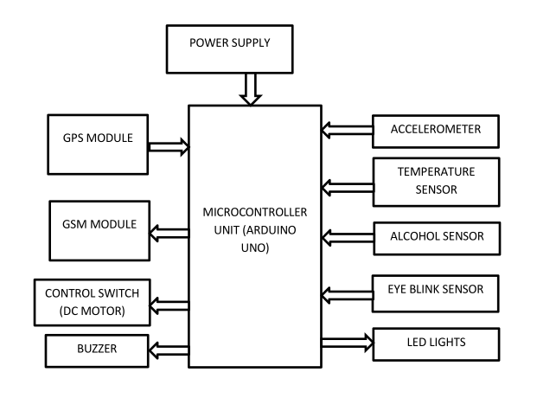
Results and Outputs

Slide 10
Conclusion
The proposed system is developed to provide the information about the accident occur and the location of the accident .
It helps to easily provide the assistant and help to the victim of the accident. T
his system uses GPS module to locate the vehicle.
GSM is used to provide the information of accident. The results of the proposed systems are satisfactory.
Our idea is used to detect accident and automate emergency assistance services. As a result, system is sending SMS to the nearest Emergency assistance service provider from accident location
This design is a system which can detect accidents in significantly less time and sends the basic information. This alert message is sent to the rescue team in a short time, which will help in saving the valuable lives

Slide 11
Future Scope
Future technology will make it simple to create a tiny version of this intelligent system that can be utilised everywhere.
It will be very beneficial for safety measures, and the accident rate will significantly drop. Additionally, it will be significant for the vehicle sector.

Slide 12
References
https://electronicsworkshops.com/2021/07/05/accident-prevention-detection-and-reporting-system-using-arduino/
https://www.researchgate.net/publication/333984519_An_IoT_Based_Car_Accident_Prevention_and_Detection_System_with_Smart_Brake_Control
https://nevonprojects.com/smart-road-safety-and-vehicle-accident-prevention-system-for-mountain-roads/
https://www.ijraset.com/research-paper/ai-and-iot-based-road-accident-detection#:~:text=An%20IoT%20kit%20is%20used,carry%20out%20the%20rescue%20operation.

